Slide 1

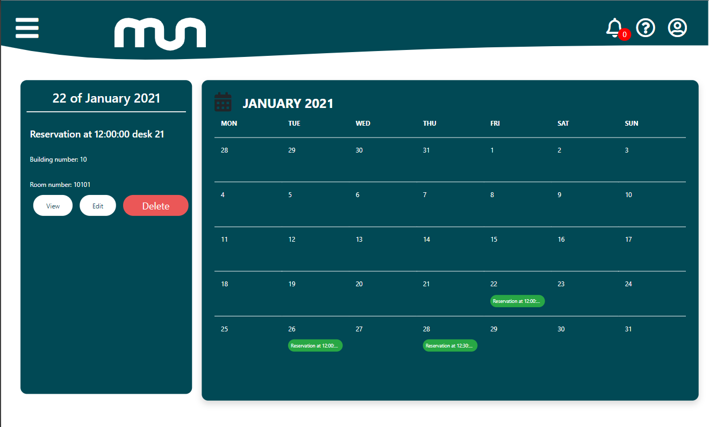





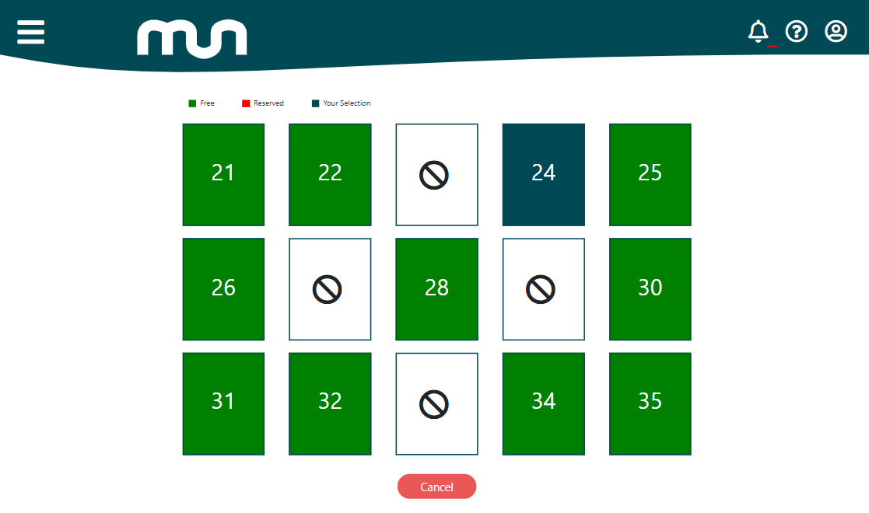

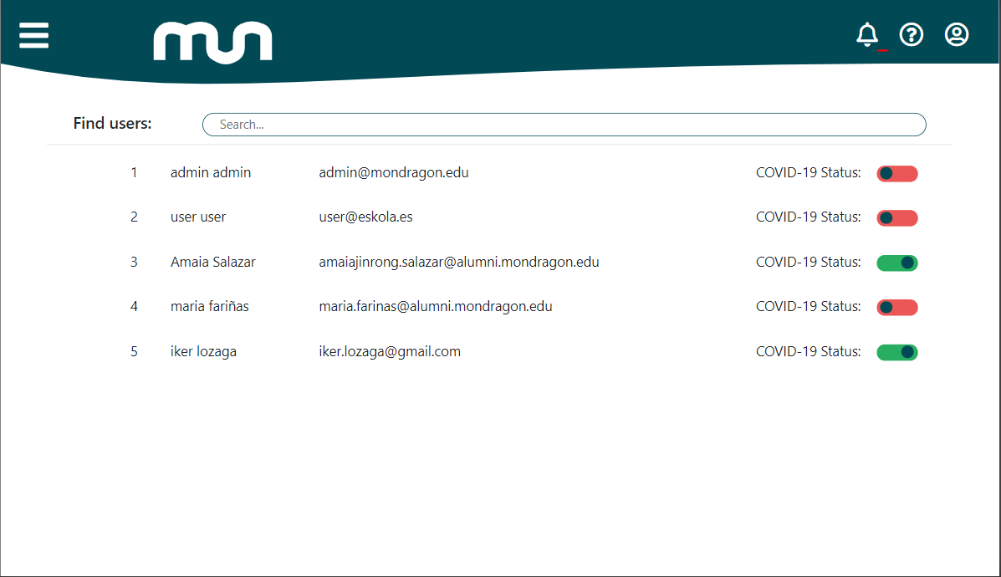
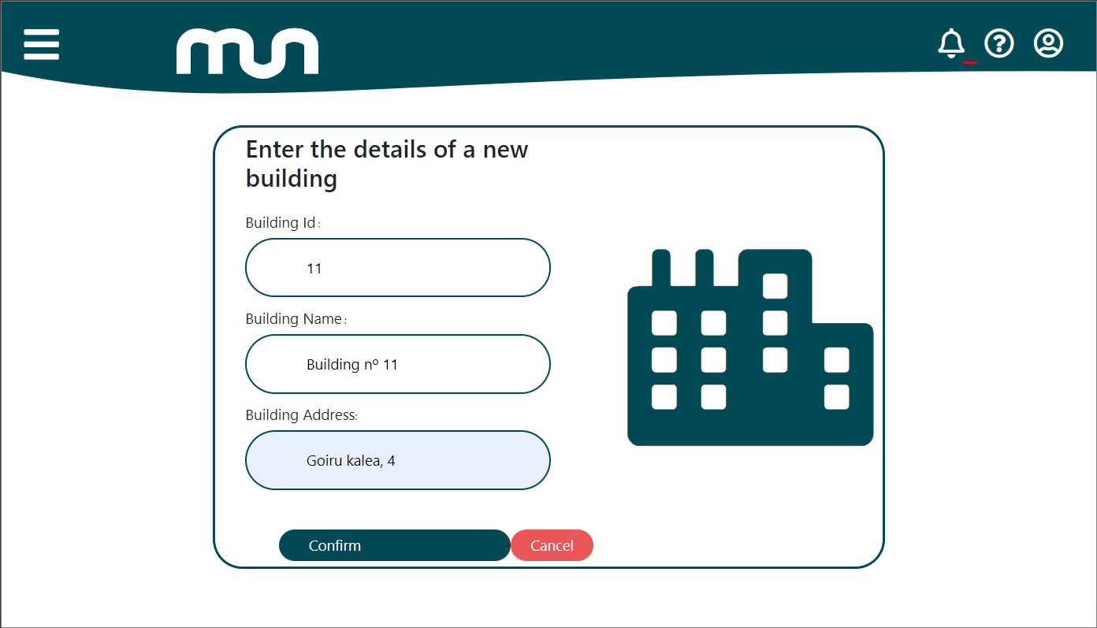
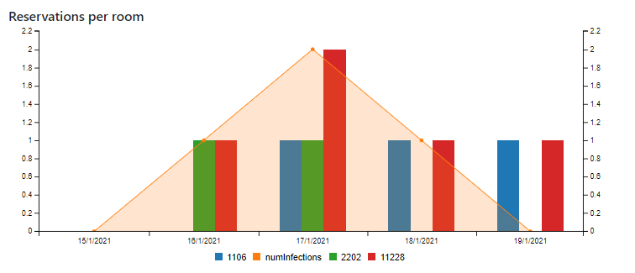

Reserve your place in the eating areas of the university, now contactless!
Cantine
Due to the global pandemic measures to avoid the spread of the virus must be taken. Thus, this web application was created to manage all the aspects of the cantines from the university, where the infection probability is higher.
Organize your week
Prevent and control
infections
Book your place in
advance
Notify posible contact
with infected people
Ask any doubts you have
For all platforms
Wide range of possibilities!
Visualize data about reservations and Covid status
Manage the Covid status of the users and notify the people that have eaten nearby
Create buildings and rooms to represent any university’s distribution
Authors:
Unai Aguinaco
Maria Fariñas
Olaia Miguélez
Unai Mendieta
Amaia Salazar
Informatics Engineering Degree
MU-Cantine
Reservation Web Application

